Slide 1

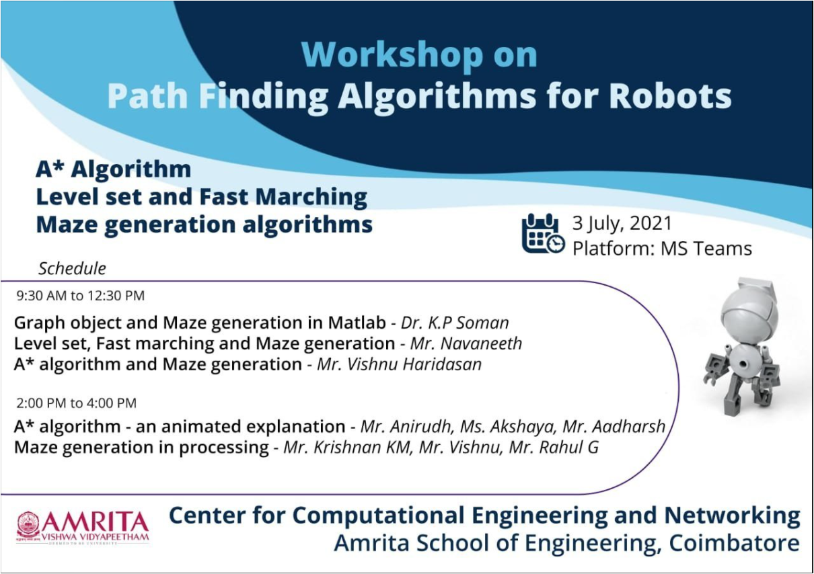


Slide 2
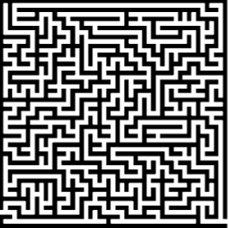
Maze generation using Processing

Slide 3
Session outcomes
To introduce the idea of maze
To generate a maze using Depth First Search algorithm (using recursive backtracking).
To visualise the generated maze using a example.

Slide 4


What is a MAZE !?
A maze is a path or collection of paths, typically from a starting point to a ending point.
There should be at least one way to get from a designated start location to a designated end.
These paths are usually complex and branched.

Slide 5
A perfect maze is a maze which is devoid of loops and non accessible areas.​
Maze can be of various types. Some types are continuous or non continuous, simple or overlapping, static or dynamic. ​

Slide 6
Maze generation
A maze can be generated by starting with a predetermined arrangement of cells with walls between them.
This predetermined arrangement can be considered as a connected graph with the edges representing possible walls and the nodes representing cells.
The purpose of the maze generation algorithm is to make a subgraph in which we find a route between two particular nodes.
We will take recursive backtracker model as an example.

Slide 7
So what's the need of all this !?
As earlier explained, we can explore the application of Maze generation in :
Game industry, Robotic learnings, Building architecture
For achieving shortest paths in various kind of urgent situations

Slide 8
Lets see how are we generating maze !?
There are various Algorithms for maze generation.
Algorithm we are using :
Recursive backtracking implementation of randomized Depth-first search algorithm.
Concepts included :
Arrays, Recursion, Stack
https://en.wikipedia.org/wiki/Maze_generation_algorithm

Slide 9
Depth-First Search
z
A large grid of cells is the space for MAZE
Each cell has 4 walls [top, right, bottom, left].
Starting from the current cell, the program randomly selects neighboring cells and removes the walls between them. This cell is mark visited and filled to the stack (Backtracking)

Slide 10
z
The program keeps on randomly selecting neighbor until it reaches the cell with no neighbor. (dead-end)​
After it encounters dead-end it backtracks through the path until it reaches a cell with an unvisited neighbor.​
This process continues until the stack is empty.​

Slide 11
Recursive Backtracking Fundamental Steps
z
Make the initial cell the current cell and mark it as visited.
1
While there are unvisited cells
2
If the current cell has neighbors which have not been visited.
Randomly choose any one of the unvisited neighbors.
Push the current cell to the stack.
Remove the wall between the current cell and chosen cell.
Make the chosen cell the current cell and mark it as visited.
Else if the stack is not empty
3
Pop a cell from the stack
Make it the current cell.
Simulation-1
Simulation-2

Slide 12
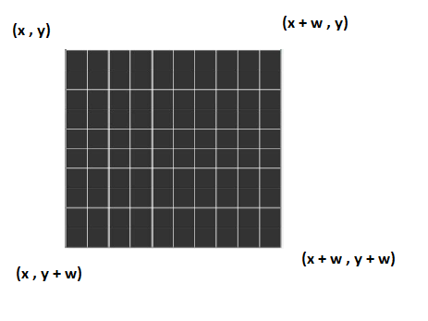
How the grids are interpreted !?

Slide 13
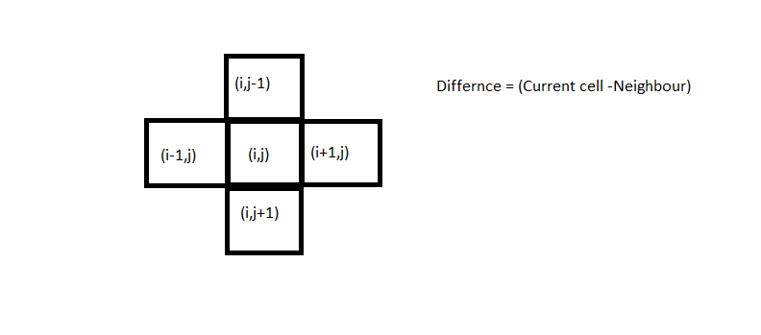

Neighbors of ( i , j )
x
y

Slide 14
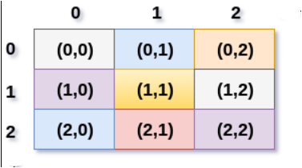
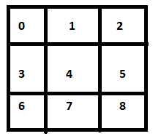
Formula for getting index in 1-D
Considering these scenario,
Here rows, cols = 3
And our formula for getting the index in 1 D is ( i + j * cols )
2-D
Here, considering middle that is (1,1) it should return size in 1-D that is 4.
Here i = 1 and j = 1 so formula will return (1 + 1*3 = 4)
1-D

Slide 15
How to solve maze !?
We already discussed one of the way to solve maze using BFS, A* path finding algorithm
When a maze has multiple solutions, the solver may want to find the shortest path from start to finish. There are several algorithms to find shortest paths, most of them coming from graph theory. One such algorithm finds the shortest path by implementing a breadth-first search, while another, the A* algorithm, uses a heuristic technique. The breadth-first search algorithm uses a queue to visit cells in increasing distance order from the start until the finish is reached. Each visited cell needs to keep track of its distance from the start or which adjacent cell nearer to the start caused it to be added to the queue. When the finish location is found, follow the path of cells backwards to the start, which is the shortest path. The breadth-first search in its simplest form has its limitations, like finding the shortest path in weighted graphs.
https://en.wikipedia.org/wiki/Maze-solving_algorithm

